Slide 1
Evaluating XAI
Master Degree in Computer Science, ICT Solutions Architect curriculum
Data Mining
A comparison of Rule-based and Example-based explanations
Jacopo Massa
Giulio Purgatorio

Slide 2
Motivation
Decision Support System (DSS)
XAI allows the DSS to generate explanations.
“Why this advice instead of that advice?”
Subjective measurements
Objective measurements
Lack of formalization

Slide 3
A practical approach
System Understanding
Trust
Persuasive Power
Task Performance

Slide 4



This paper has two objectives:
(1) Practical recommendations
(2) Comparing two explanation styles
Fact
Foil
Humans prefer contrastive explanations
Rule-based
Example-based
“if.. then..” statements
Historical situations similar to the current one

Slide 5
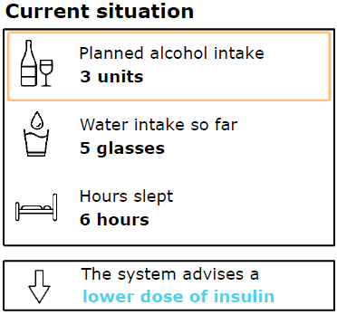
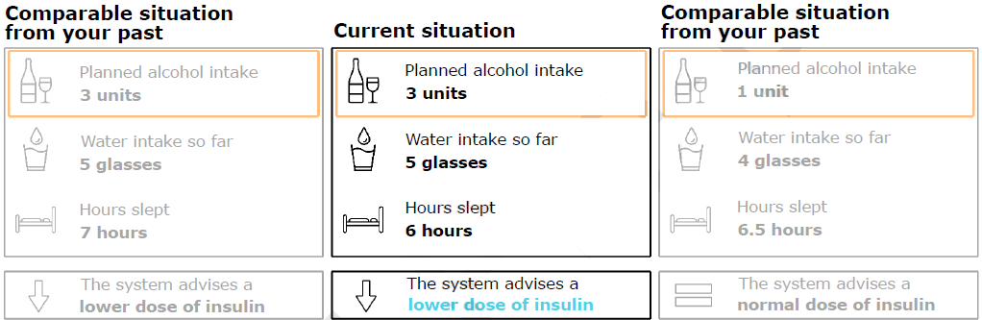
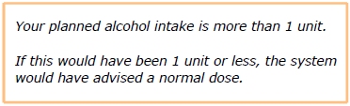
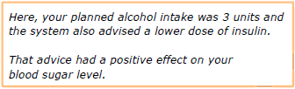
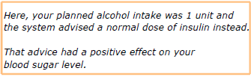
Use case
DMT1 self-management context
Rule-based
Example-based

Slide 6
Use case simplifications
Binary advices: higher or lower doses.
Novice users: no biases in their behaviors.
Explanations: not generated by XAI but by researchers instead

Slide 7
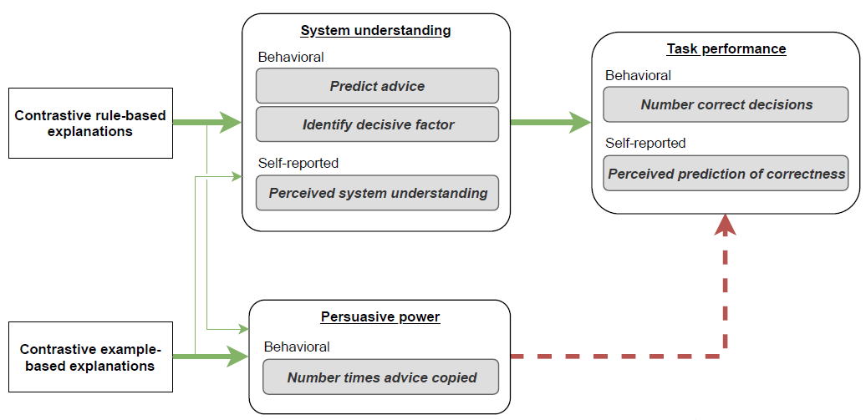

Usability questionnaire (explaination visualization)
Perceived system accuracy

Slide 8
Experimental procedure:
Pre-Questionnaire: informing participants and checking their knowledge
Learning Block: trials to familiarize with the system
Testing Block: trails to conduct measurements
Post-Questionnaire: retrieve self-reported measurements
Factors:
Hours slept
Water intake
Physical Health
Temperature
Mood
Alcohol intake
Last insulin dose
…
Exp. 1
System understanding
Exp. 2
Persuasive power & Task performance

Slide 9
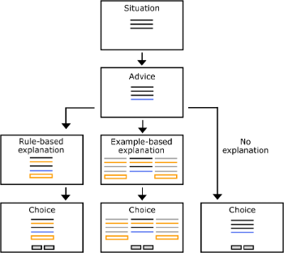
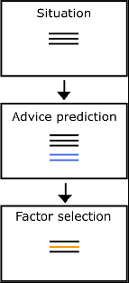
Experiment 1
Learning Block
18 trials (each with 3 random factors)
Testing Block
30 trials (still random)

Slide 10
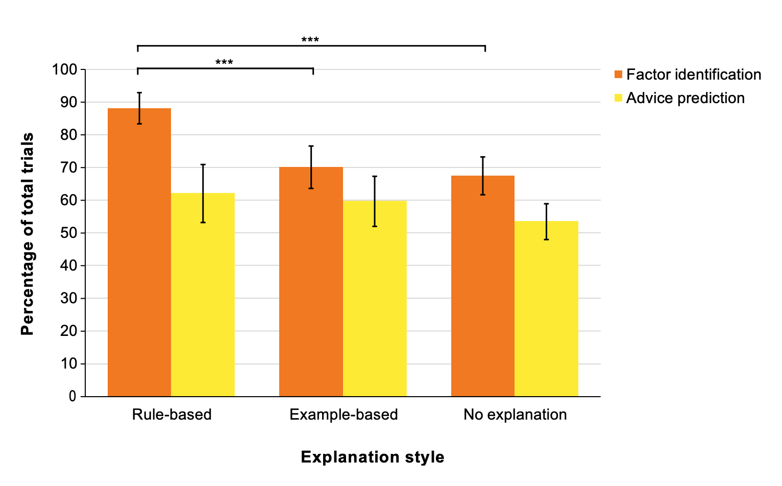
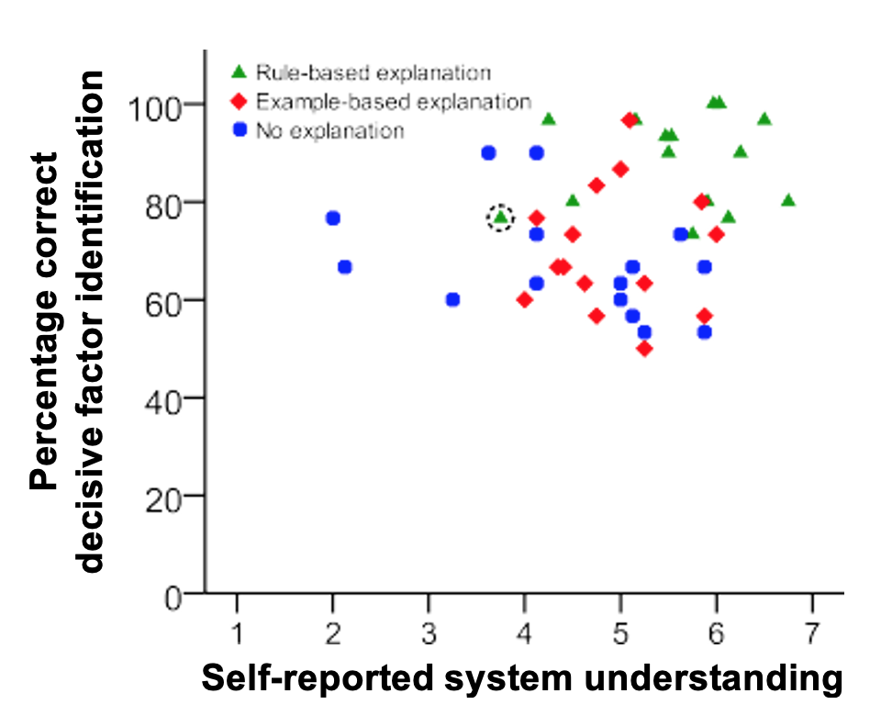
Results Exp 1

Slide 11
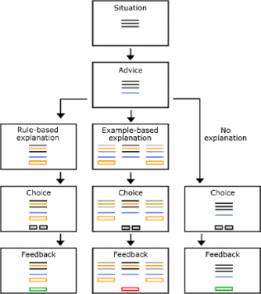
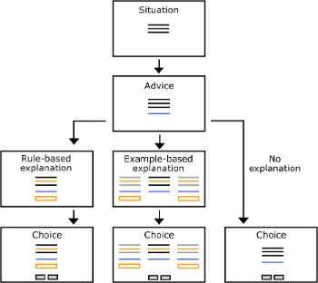
Experiment 2
Learning Block
Same as Exp. 1 + feedback on decision’s correctness
Testing Block

Slide 12
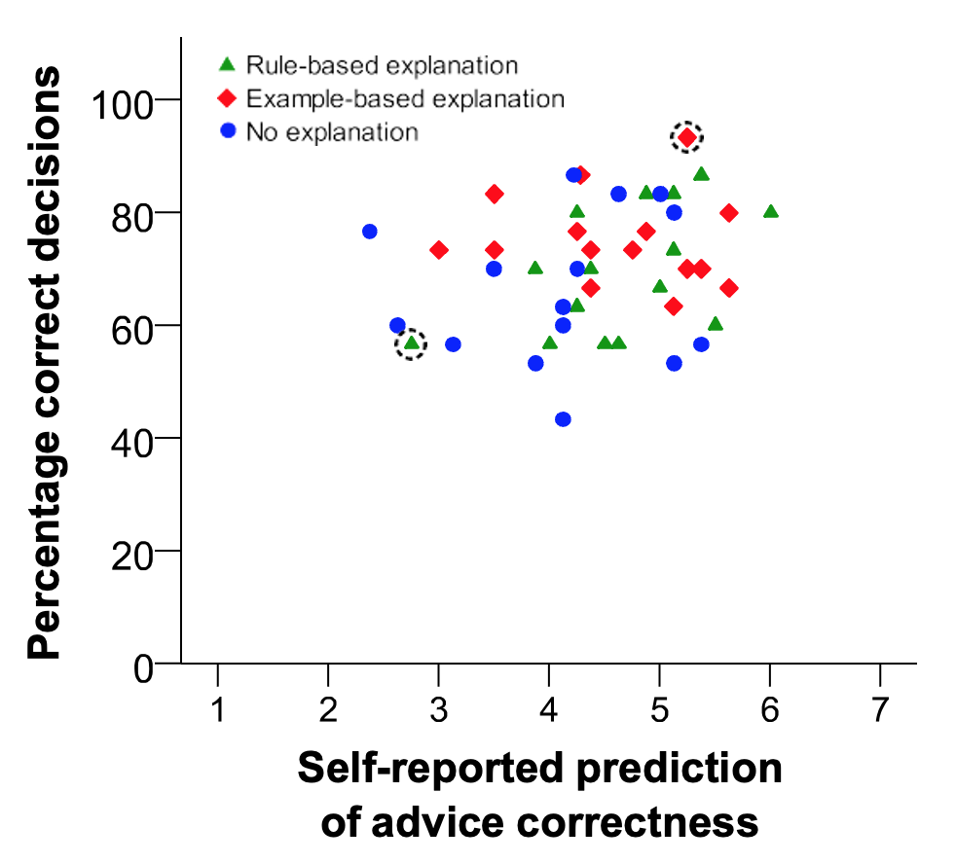
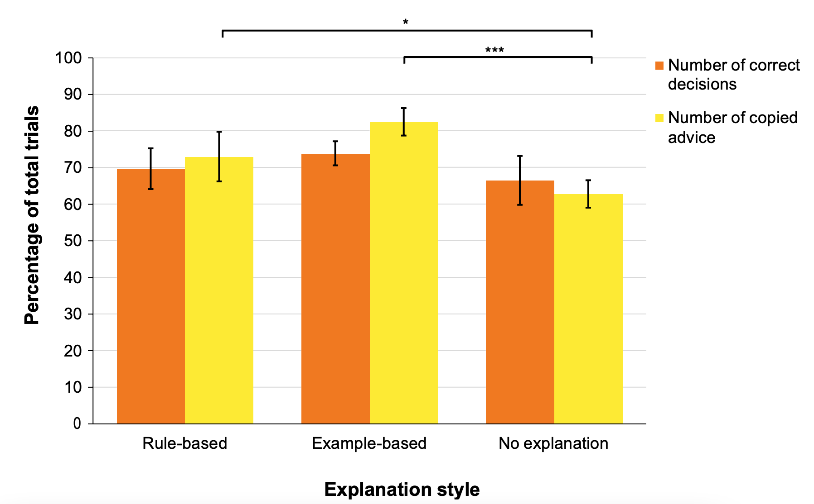
Results Exp 2

Slide 13

To read the original paper, follow this link

